Slide 1
DETECTING SIMILARITY BETWEEN QUORA QUESTIONS USING MACHINE LEARNING TECHNIQUES
RITI GUPTA & SUNHERA PAUL

Slide 2
AGENDA
INTRODUCTION
DATASET
CLEANING
FEATURE EXTRACTION
ML MODELS USED AND THEIR ACCURACY
RANDOM FOREST
XGBOOST
SVM
NEURAL NETWORKS
CONCLUSION

Slide 3
INTRODUCTION
In order to build a high-quality knowledge base, it's important that each unique question exists on Quora only once.
avoid multiple versions
readers should be able to find a single canonical page for the questions
EXAMPLE :
Duplicate Questions :
Why did Trump win the Presidency?
How did Donald Trump win the 2016 Presidential Election?
Non-duplicate questions
How can I start an online shopping (e-commerce) website?
Which web technology is best suitable for building a big E-Commerce website?
Can be implemented in various other Q&A portals like Stack Overflow

Slide 4
SECURING THE DATASET
http://qim.fs.quoracdn.net/quora_duplicate_questions.tsv
Publicly available by Quora
Contains actual questions on quora
Total sample : 400,000 pairs of questions
250,000 duplicate
150,000 non-duplicate
Each line contains space separated information
id: the id of a question pair
qid1, unique ids of each question
question1, question2 - the full text of each question is_duplicate - the target variable, set to 1 if question1 and question2 have the same meaning, and 0 otherwise.

Slide 5
DATA CLEANING
Remove punctuation marks
Modify the special characters($,%,&) to words
Remove comma from between the numbers greater than 999.
Don’t remove stop words
Don’t apply stemming to words

Slide 6
FEATURE ENGINEERING
Count Vectorizer:
It represents the words that are present in the questions in our case and the number of occurrences of the words which specify the importance of the words
TF-IDF:
The term frequency summarizes the number of times a word has appeared within a question whereas the inverse document frequency downscales the words that have appeared numerous times across questions
N-gram word TFIDF (N=2,3)
N-gram character TFIDF (N=2,3)
Common Features:
The number of words in question
The number of characters in question
The length of the common word in the questions
The difference in the length of the questions

Slide 7
FEATURE ENGINEERING
Fuzzy string matching:
It is a technique of matching strings where the strings are matched approximately.
Useful in case of typographical errors, missing words
Partial_ratio
fuzzy_qratio
Fuzzy_wratio
Partial_token_set ratio
Partial_token_sort_ratio
Token_set_ratio
Token_sort_ratio
WMD(Word Mover’s Distance):
It measures the dissimilarity between two text documents as the minimum amount of distance that the embedded words of one document need to travel to reach the embedded words of another document.
Normalized WMD scores used as well
Sentence2vector embeddings:

Slide 8
FEATURE ENGINEERING
The cosine distance
The Manhattan distance
The Jaccard distance
The Canberra distance
The Euclidean distance
The Minkowski distance (power = 3)
The Bray-Curtis distance
The skew and kurtosis of the vectors

Slide 9
MACHINE LEARNING TECHNIQUES
Random Forest Classifier:
It builds multiple decision trees on the features available and then merges the results together to get a more accurate prediction.
XGBoosting Algorithm:
It builds trees one at a time, where each new tree helps to correct the errors made by the previous tree.
Support Vector Machine:
Supervised learning method which defines a separating hyperplane to classify the dataset given.
Kernels used : Linear, RBF
Logistic Regression:
We have used threshold value of 0.5

Slide 10
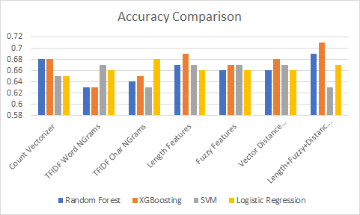
ACCURACY COMPARISON

Slide 11
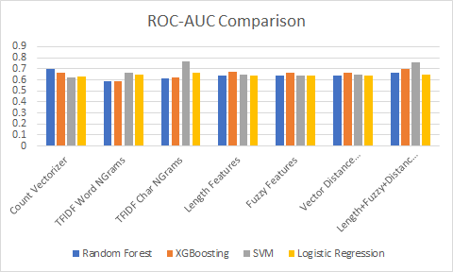
ROC AUC COMPARISON

Slide 12
DEEP LEARNING
DATA PREPARATION
Built a vocabulary of all words in dataset
Split the data into test(0.33) and train data (0.67)
LAYERS IN MODEL BUILT
LSTM
Embeddings layer
Used GloVe embeddings
Convolutional 1D
MaxPooling
Dropout Layers (To avoid overfitting)
Batch normalization

Slide 13
DEEP LEARNING (ConT..)
Activation functions used:
Hidden layers : Relu
Output layer : sigmoid

Slide 14
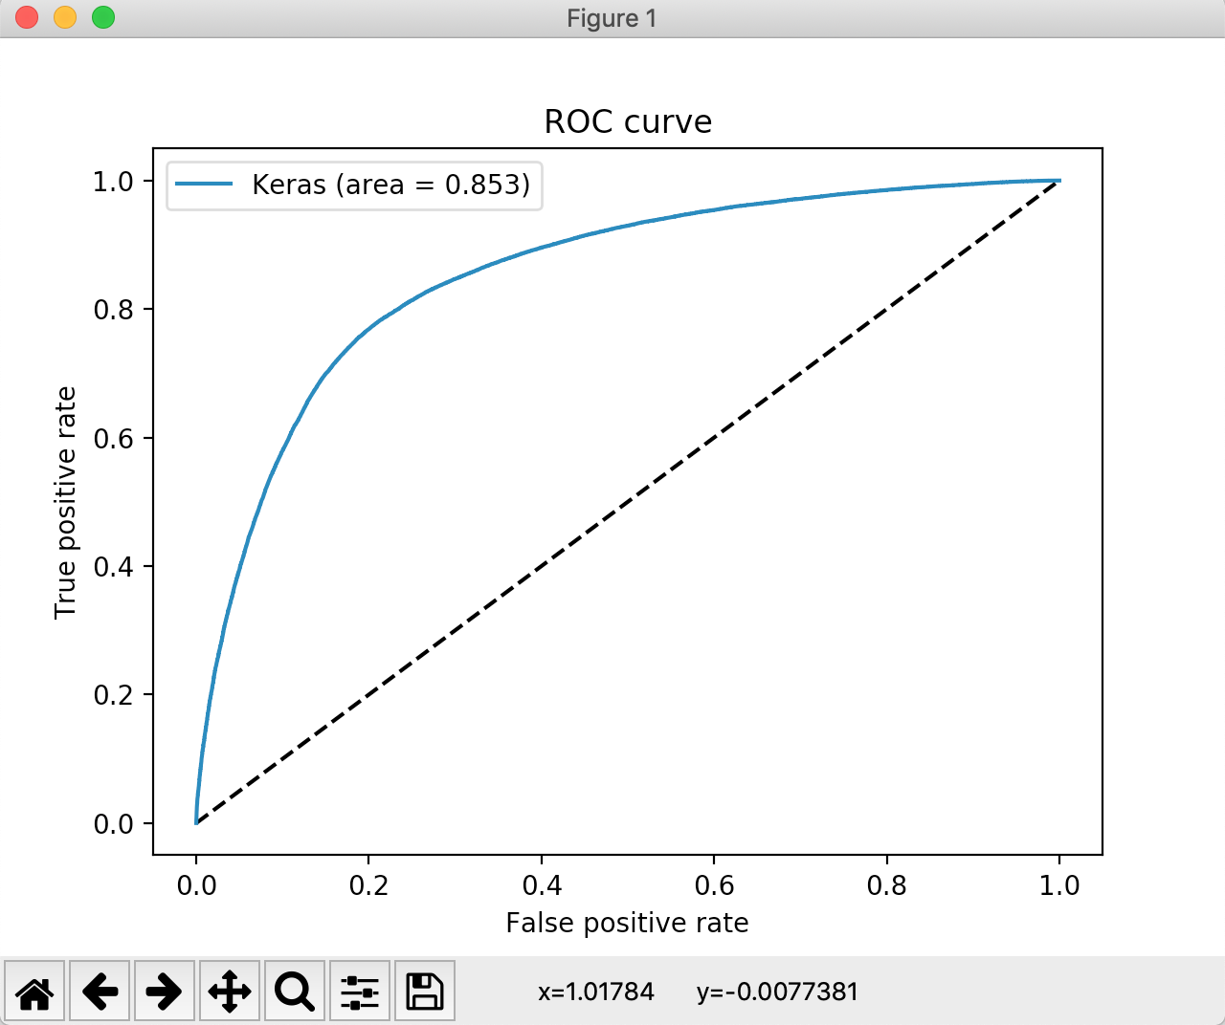
EVALUATION
Time taken : 12 hours for 38 epochs
Accuracy achieved on test data
0.80142
ROC Curve
Area under the curve : 0.853

Slide 15
CONFUSION MATRIX
Plotted confusion matrix with various thresholds (0.3,0.5,0.7)
All seem to be giving similar results

Slide 16
references
https://data.quora.com/First-Quora-Dataset-Release-Question-Pairs
https://engineering.quora.com/Semantic-Question-Matching-with-Deep-Learning
https://towardsml.com/2018/06/12/understanding-word-embeddings/
https://nlp.stanford.edu/projects/glove/
J. Pennington, R. Socher, C. D. Manning : GloVe: Global Vectors for Word Representation, Computer Science Department, Stanford University, Stanford, CA 94305
https://scikit-learn.org/stable/modules/generated/sklearn.feature_extraction.text.CountVectorizer.html
http://www.tfidf.com/
https://markroxor.github.io/gensim/static/notebooks/WMD_tutorial.html

Slide 17
THANKS

